Slide 1
Welcome to American Literature

Slide 2
Romanticism
Imagination
Intuition
Idealism
Inspiration
Individuality

Slide 3
The Dual Types of Romantic Literature: Dark and Light
**Both of these aspects of the Romantic movement involve emotional responses to one’s environment, relationships, and place in the world. They both emphasize the psychological, and they seek to present the world in a “hightened” state/a state of extremes.

Slide 4
Terms to Know, Group #1:
Allegory
Symbol
Literary Movements
Romanticism
Gothic Literature: Gothic Romantic/Gothic Horror
Setting
Narrator

Slide 5
Elements of Romantic Gothicism in Poe’s Fiction
Grim setting yet idealized/ “otherworldly”
Landscapes are often reflections of a character’s mind
Unusual buildings, extremes of nature, eccentric works of art/wealth contrasted with the idea of the “outsider” or “outcast”
Very few of his stories take place in America; most take place in Europe or Never-never-land

Slide 6
Other elements of the Gothic
Longing for “completion” brought by reunion with a lost love (most often dead)
Death is presented as a blessing or at least a comfort
Hidden evil; unspeakable, mysterious crimes, including incest and parricide
Obsession with Death
Ghosts, blood, body parts
Maniacal Laughter
The discovered manuscript
Deformity; the grotesque--people who have deformities are capable of activity beyond the norm

Slide 7
Edgar Allan Poe (1809-1849)
“From childhood's hour, I have not been as others were; I have not seen as others saw. I could not awaken my heart to joy at the same tone--and all I loved, I loved alone.”
― Edgar Allan Poe

Slide 8
Poe’s Difficult Life
Legend/Myth vs. Historical Record
Poe actually responsible for Myths (in part)
Literary executor’s “smear campaign”
Outlandish accusations (from alcoholism and drug addiction to necrophilia and madness)
Alcoholism; resulting poverty and poor health

Slide 9
Early Life
Born in Boston on January 19, 1809
Father deserted the family one year later
December 1811, his mother died at twenty-four
John Allan, a successful Richmond tobacco merchant
Allan was distant/womanizer and abusive

Slide 10
College and West Point
1826, University of Virginia
Allan provided only one-third of the money he needed
Gambling to raise money for expenses
Humiliated by his poverty, Poe returned to Richmond and visited the home of his fiancée Elmira Royster
Attended West Point--thrown out later for failure to attend classes

Slide 11
Allan died, Poe left out of Will
Editorial position at the Southern Literary Messenger in Richmond
Reputation as a fearless critic
At 27, brought Maria and Virginia Clemm to Richmond
Married Virginia, who was not yet 14
1842 Poe’s wife contracted tuberculosis

Slide 12
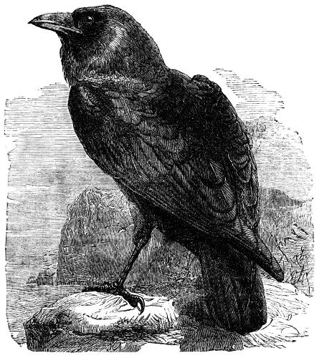
1845 publication of “The Raven” made Poe
a household name
Published two books that year
His wife’s deteriorating health and rumors spreading about Poe’s relationship with a married woman drove him out of the city

Slide 13
The winter of 1847 that Virginia died at the age of 24
Poe only lived another 2 years

Slide 14
Poe’s Death
During the last two years of his life, Poe was seriously ill.
Election Day, October 3, 1849, he was found senseless and wandering the streets
Taken to a hospital, he died on October 7, “of congestion of the brain.”
Various theories concerning cause of death
Scholars agree that he suffered from the effects of severe alcoholism.

Slide 15
Poe worked in a variety of genres (1827-1849)
Criticism--he gained a national reputation as a virulently sarcastic critic, a literary hatchet-man
Poetry--He was an experimental poet
Psychological fiction--He wanted to produce the greatest possible horrific effects on the reader
Detective Story--Poe created this form when he was 32.

Slide 16
Poe and the Gothic
Poe did not want to write Gothic stories; he started his career spoofing the Gothic.
He said that he wrote, “Tales of terror…of the soul.”
He transformed tales of terror into psychological stories

Slide 17
An Element of Poe’s style
Poe uses vocabulary to create setting, for rhetorical effect, rather than for information.
Modern horror films use music to create atmosphere; Poe used vocabulary.

Slide 18
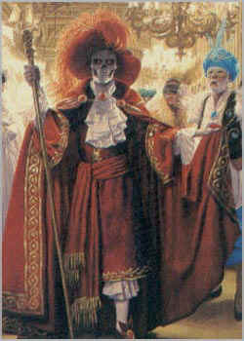
The Masque of the Red Death
Published in 1842

Slide 19
The Raven
Published in 1845

Slide 20
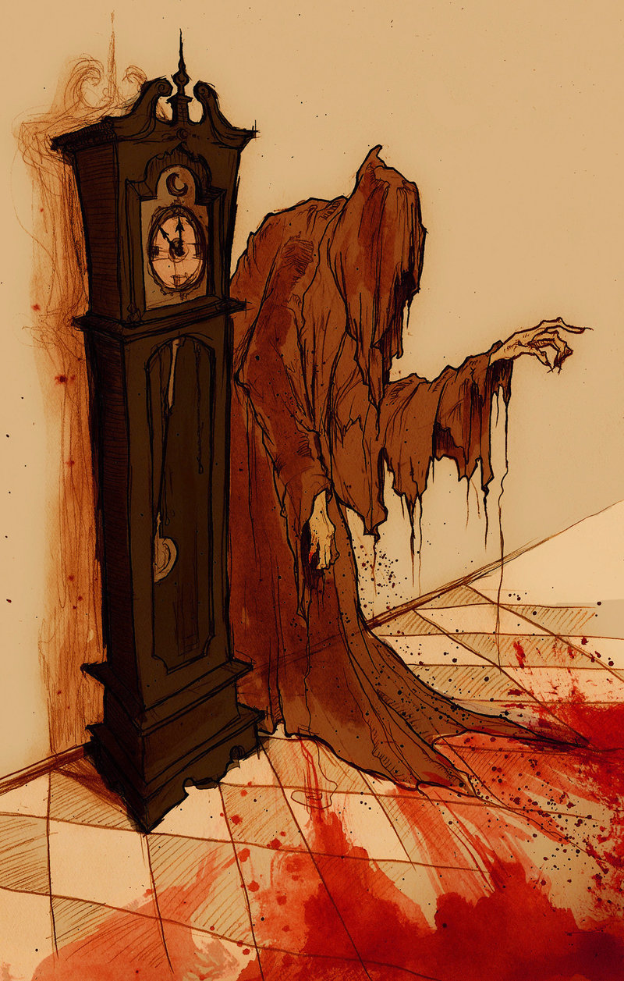
What is an Allegory?
A type of story in which the characters, settings, and events are an interconnected series of SYMBOLS.
The deeper or symbolic meaning of the story may contain a moral/comment on human existence

Slide 21
What is the background/setting
Setting during the bubonic plague - 14th and 17th centuries
Bubonic plague was an illness carried by fleas who bit rats that traveled on ships
The Black Death is estimated to have killed 30% – 60% of Europe's population
Symptoms –boils in the groin, the neck and armpits, which oozed pus and bled when opened – vomiting blood, fever

Slide 22
Masks
Death
Red Death Plague
Human falsity
Need for status/title

Slide 23
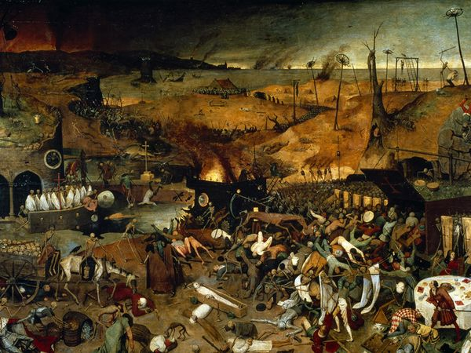
Why do Prince Prospero and his followers retreat to his palace?

Slide 24
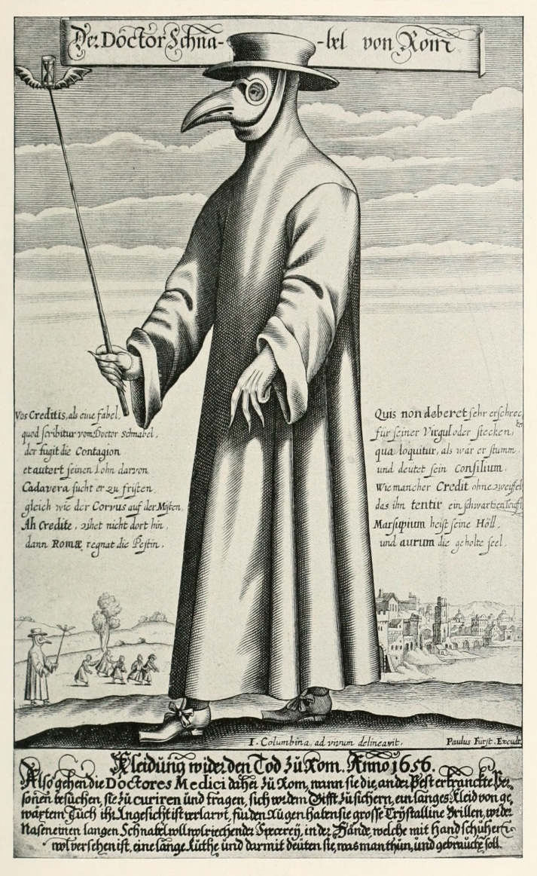
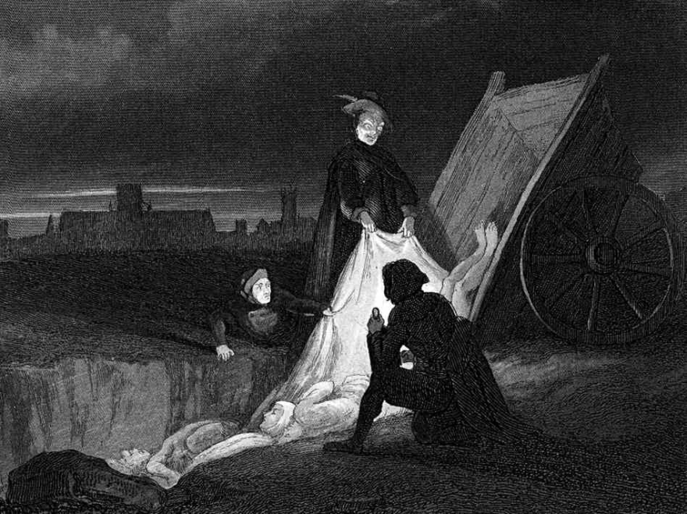
The Black Plague
1300-1400
Some later outbreaks

