Slide 1
Gothic Literature
continued...

Slide 2
Review of Concepts/Week One
What is Gothic literature?
Characteristics of Gothic literature
Describe Poe's early life
Understand and be able to discuss “The Masque of the Red Death”
**First formal review next week!
It will cover all lecture content, The Raven, The Masque of the Red Death, Poe and Dickinson's biographies, and Dickinson's poems**

Slide 3
Due Tonight/Reminders:
Make sure you’ve submitted the Question Set from last week on The Masque of the Red Death
Submit Question Set #2 from Poe’s The Raven and from the Emily Dickinson poems
Submit tonight’s Warm-up
Complete the first study guide and use it to help you with the first quiz next week

Slide 4
19th Century: More than just ghost stories...
D.W. Kellogg, WOMAN MOURNING BY TOMB (ca. 1842) courtesy of Library of Congress, Prints and Photographs Division [LC-USZC4-1840].

Slide 5
Themes in Gothic Literature
Good and Evil
Victorian social values as intrinsically hypocritical (i.e., people "are not what they seem")
Social anxiety/change/fear of the unknown
The "overreaching" man/Prometheus
The "internal world" as a complex place

Slide 6
Francisco Goya's "The Spell"

Slide 7
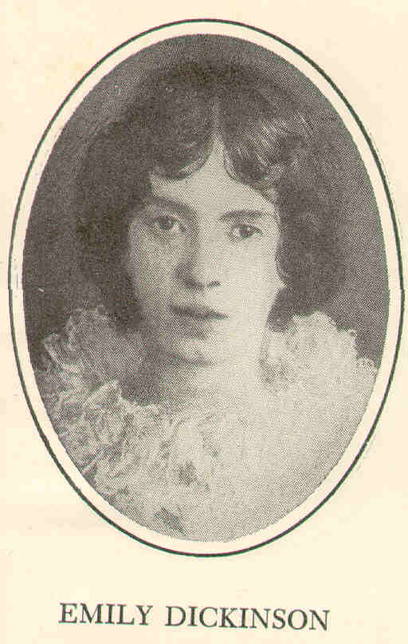
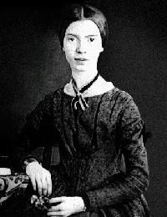
Dickinson
Born in 1830 in rural Amherst, Massachusetts
Spent her entire life in the household of her parents
Often produced a poem a day
Began to dress only in white—a habit that added to her reputation as an eccentric

Slide 8
Myth of “fragile innocence”
Seclusion was not the result of a failed love affair, but rather a part of a more general pattern of renunciation
She defined herself; wrote voraciously to many friends across the U.S.
Died in 1886 (56 years old)

Slide 9
Her Poetry
Dashes and pauses
Ellipses and the “unspoken”
Ferocity of feeling
One of the most easily identifiable poets in American Literature (look for dashes and ellipses)
“Quiet minds think the loudest thoughts.”
Multiple readings:
From sensual ecstasy to religious ecstasy

Slide 10
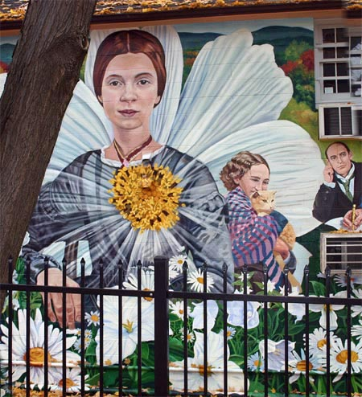
Her Poetry:
I heard a fly buzz
I felt a funeral in my brain
Because I could not stop for Death
The Bustle in a House

Slide 11
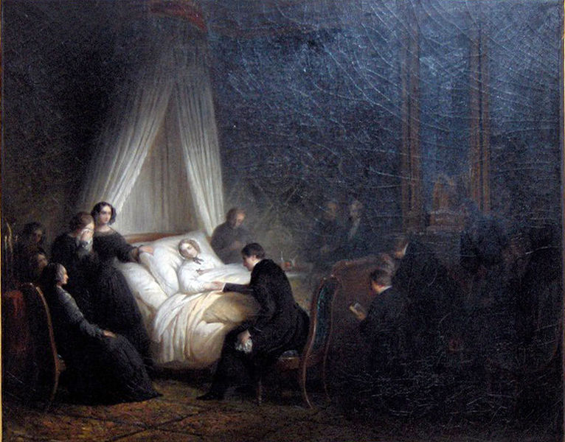
I heard a fly buzz…
I heard a Fly buzz – when I died –
The Stillness in the Room
Was like the Stillness in the Air –
Between the Heaves of Storm –
The Eyes around – had wrung them dry –
And Breaths were gathering firm
For that last Onset – when the King
Be witnessed – in the Room –
I willed my Keepsakes – Signed away
What portions of me be
Assignable – and then it was
There interposed a Fly –
With Blue – uncertain stumbling Buzz –
Between the light – and me –
And then the Windows failed – and then
I could not see to see –

Slide 12
I felt a funeral in my brain
I felt a Funeral, in my Brain,
And Mourners to and fro
Kept treading – treading – till it seemed
That Sense was breaking through –
And when they all were seated,
A Service, like a Drum –
Kept beating – beating – till I thought
My Mind was going numb –
And then I heard them lift a Box
And creak across my Soul
With those same Boots of Lead, again,
Then Space – began to toll,
As all the Heavens were a Bell,
And Being, but an Ear,
And I, and Silence, some strange Race
Wrecked, solitary, here –
As all the Heavens were a Bell,
And Being, but an Ear,
And I, and Silence, some strange Race
Wrecked, solitary, here –
And then a Plank in Reason, broke,
And I dropped down, and down –
And hit a World, at every plunge,
And Finished knowing – then –

Slide 13
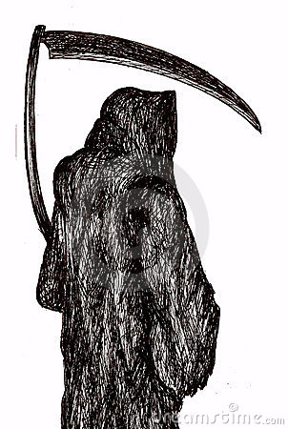
Because I could not stop for Death
Because I could not stop for Death –
He kindly stopped for me –
The Carriage held but just Ourselves –
And Immortality.
We slowly drove – He knew no haste
And I had put away
My labor and my leisure too,
For His Civility –
We passed the School, where Children strove
At Recess – in the Ring –
We passed the Fields of Gazing Grain –
We passed the Setting Sun –
Or rather – He passed us –
The Dews drew quivering and chill –
For only Gossamer, my Gown –
My Tippet – only Tulle –
Or rather – He passed us –
The Dews drew quivering and chill –
For only Gossamer, my Gown –
My Tippet – only Tulle –
We paused before a House that seemed
A Swelling of the Ground –
The Roof was scarcely visible –
The Cornice – in the Ground –
Since then – ‘tis Centuries – and yet
Feels shorter than the Day
I first surmised the Horses’ Heads
Were toward Eternity –
Personification

Slide 14
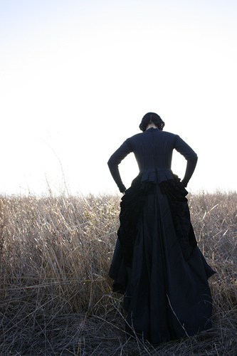
The Bustle in a House (1108)
The Bustle in a House
The Morning after Death
Is solemnest of industries
Enacted upon Earth –
The Sweeping up the Heart
And putting Love away
We shall not want to use again
Until Eternity –

