Slide 1
College Composition I
Ms. McDaniel
757-663-8700

Slide 2
Essay Structure
Introduction—Thesis Statement
Body—Support and Details
Conclusion—Summation and Assertion
More on this in a moment…

Slide 3
General Format
Your essay should:
be typed and double-spaced
be printed on standard-sized paper (8.5 inch x11 inch)
have 1 inch margins on all sides
use 10-12 pt. Times New Roman or a similar font
have a title, centered, on the first page
include page numbers in the upper right-hand corner
your name, the course name and number, the instructor’s name, and the date in the upper left hand corner of the first page
double-space all writing
indent all new paragraphs five spaces
Notes:
This slide presents the general format of an APA formatted paper: An essay should be typed and double-spaced on the standard-sized paper (8.5”x11”) with 1” margins on all sides. Times New Roman or similar font in 10-12 pt. size should be used. The document should include a page header indicating a short title of the essay and a page number in the upper right-hand of every page (including the title page).

Slide 4
Important Online Resources
Purdue Online Writing Lab
Visit the Online Writing Lab (called OWL) whenever you have an APA question. OWL can be accessed at: http://owl.english.purdue.edu/owl/resource/560/01/
Our Course Materials
http://goodwritingdays.com

Slide 5
Learning Goals for this Course
Five major goals:
Rhetorical knowledge and analysis
Critical thinking, reading, and writing
Writing processes/methods
Knowledge of standards conventions
Composing in electronic environments

Slide 6
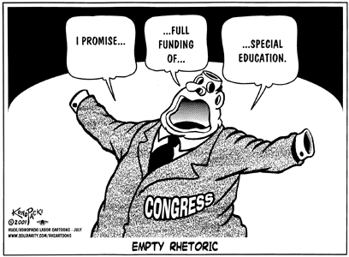
What is Rhetoric?
Rhetoric is a method (or set of methods) for conveying ideas to an audience—whether in written or spoken form

Slide 7
Product
(Essay, Speech, etc.)
How Rhetoric Works…
INTENT
EXPECTATIONS
Rhetor
Audience

Slide 8
Tools of Rhetoric
Ethos: the use of cultural norms or understanding to convince an audience of an idea
Logos: the use of logic to convince an audience of an idea
Pathos: the use of emotion to convince an audience of an idea
We’ll talk about these a lot this term!

Slide 9
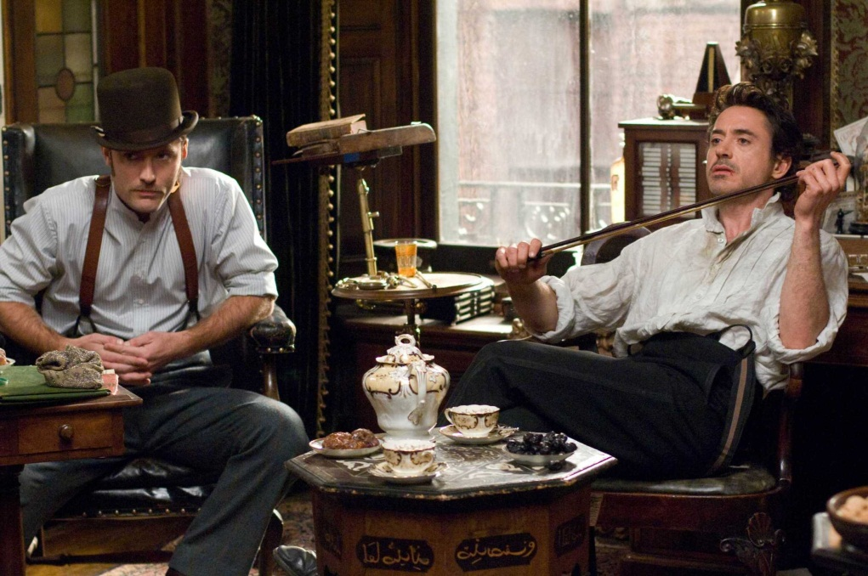
Logos: Logic
The Logical Appeal:
This + This = That
The cook is dead.
His body is in the kitchen.
There are muddy footprints
leading up to the body and away from it.
The butler is wearing muddy shoes,
and his shoes are the same size
as the muddy prints.
The butler did it!

Slide 10
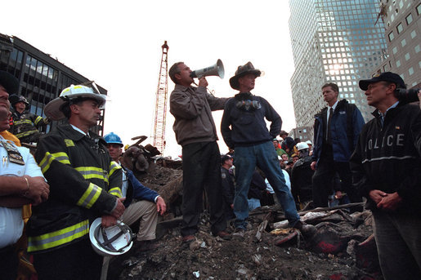
Ethos
The Appeal of Character or Culture:
“Thank you all. I want you all to know -- it [bullhorn] can't go any louder -- I want you all to know that American today, American today is on bended knee, in prayer for the people whose lives were lost here, for the workers who work here, for the families who mourn.
The nation stands with the good people of New York City and New Jersey and Connecticut as we mourn the loss of thousands of our citizens”
http://www.americanrhetoric.com/speeches/gwbush911groundzerobullhorn.htm

Slide 11
Pathos
The Appeal to
Emotion:

Slide 12
Aspects of Rhetoric
Audience –expectations and needs
Purpose – reason for writing
Rhetorical situation – (consists of)
Writer, Purpose/Expectations, Audience, Topic,
Context
Writer’s voice – personality that is revealed
Writer’s tone – attitude towards the topic
Context – circumstances surrounding writing
Medium – physical or electronic means
Genre – conventions of a kind of writing

Slide 13
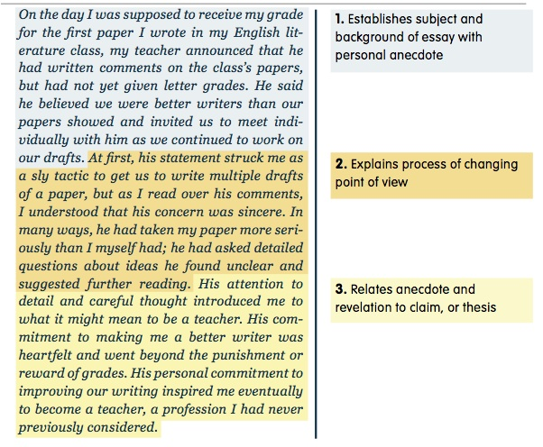
Essays
“I”/the writer’s point of view
Thesis Statement
Support through the use of examples, explanation, stories, description, and/or research

Slide 14
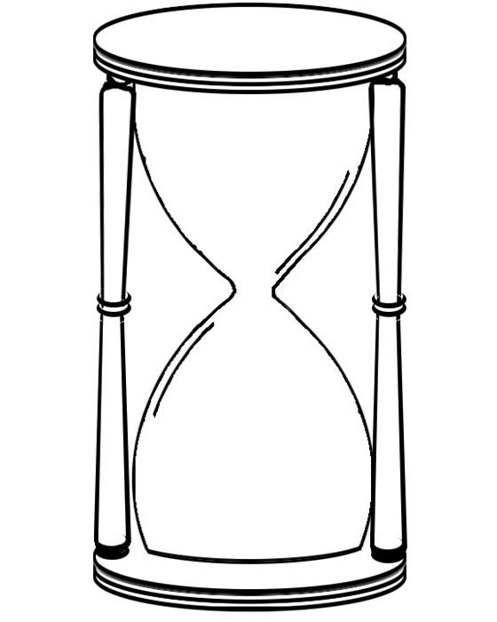
Essays are like…
Introduction--broad but with a limited SCOPE to suit the length of the assignment
Body—very specific and limited only to support for the thesis introduced in your introduction
Conclusion—returns to the “broad” approach of the Introduction but focuses on what was covered in the piece of writing and what the writer should have learned or understand at the end

Slide 15
Writing Process
Generating initial ideas (Prewriting)
Relating those ideas to the writing situation or assignment (Drafting)
Organizing ideas and writing an initial draft (Drafting)
Shaping the paper, frequently with the advice of other readers (Revision)
Editing and polishing the paper, with an eye towards line-by-line awareness of clarity , grammar, and punctuation (Editing)

Slide 16
The “So What?” Factor
What is it that you want the reader to know?
What could they gain from learning about your experience?
What’s your focus?

Slide 17
Show…don’t tell!
Descriptive details
Set a scene (pretend you’re watching a movie)
Focus on the five senses
Showing is much more powerful than telling; creates a connection with the reader

Slide 18
Genres
Narrative
Compare/Contrast
Persuasive
Argumentative
Expository

Slide 19
The Writing Process
Prewriting
Drafting
Revision
Editing
Proofreading
Other concepts we’ll cover:
Peer Reviews
Conferencing

Slide 20
Prewriting and the Thesis
The Thesis Statement is the central idea of your essay.
All details support this point
It is located early in your essay
It is a clearly-crafted statement (never a question)
It is limited in SCOPE

Slide 21
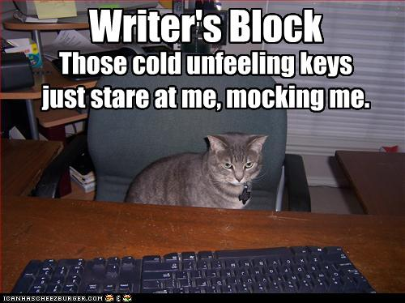
The Writing Process
Prewriting
Generate ideas
Raw material
No judgment!
Prevents
“writer’s block”

Slide 22
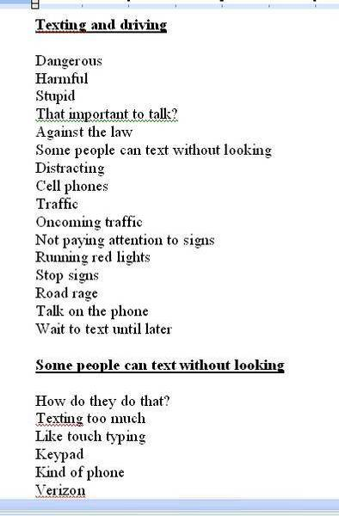
Prewriting Strategies
Brainstorming-
Looks like a grocery list

Slide 23
Freewriting-
Example: I have to write a paper about the environment. I have no idea where to start! I know there are many problems with the environment, but I don’t know much about this topic. Maybe I could take a look at my biology book to come up with some ideas. I know my biology professor is also really into the environment, so maybe I could ask for his help. I remember he was talking about hybrid cars in class the other day and how much better those are for the environment. What is a hybrid car? I know it uses some sort of alternative fuel and they are becoming very popular. Maybe that is something I could write about…
http://faculty.ncwc.edu/lakirby/English%20090/prewriting_strategies.htm

Slide 24
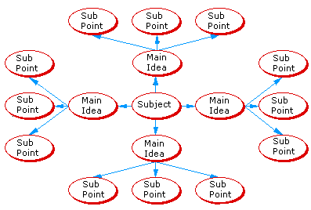
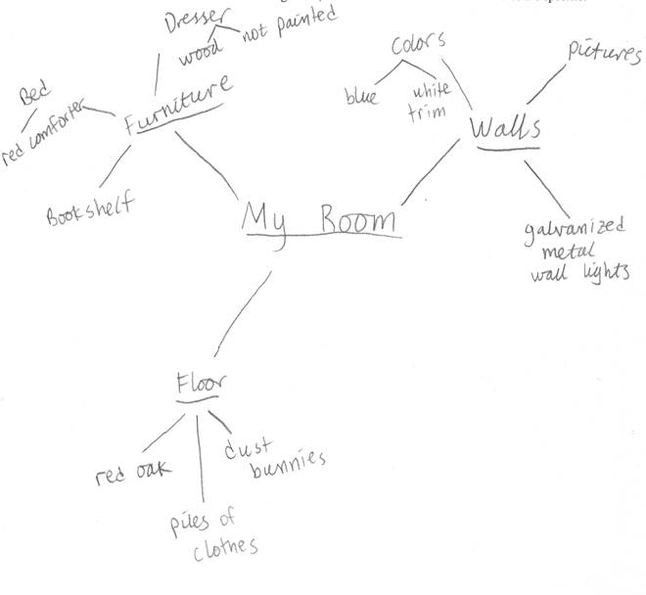
Clustering or Mapping-

Slide 25
Reading Critically for College and for Life
McGraw-Hill Guide: Chapter 2

Slide 26
Critical Thinking, Reading, Writing
Critical Thinking – when you examine an idea from many perspectives
Helps you read more thoughtfully and generate ideas and material for writing
The most politically and economically powerful people tend to be those who use critical thinking and language

Slide 27
Why Read Critically?
Helps you understand the information
Improves your writing skills
Helps you understand what makes writing “effective” or not
Engages you in an active process of constructing meaning, a skill necessary in college classes and work

Slide 28
Pre-Reading Strategies
Think about your rhetorical purpose in reading – What are you hoping to accomplish?
Preview the contents and design of each chapter
An abstract gives you a quick summary of what you will read

Slide 29
Active Reading Strategies
Ask yourself questions about the thesis, topic, supporting information, and the reliability of sources as you read
Strategies
Annotate
Perform rhetorical analysis
Read visuals critically

Slide 30
Annotate
Underline the main point or thesis
Underline key supporting points and indicate in the margins why each is important
List any questions you have
Comment on the text with your own remarks
Write down key terms and their definitions
Mark summary sections

Slide 31
Comprehending
To understand college-level assignments, be prepared to read the text more than once
The first time through, focus on getting the gist, or comprehending, the text
Remember to begin by previewing the text:
Note the title/subtitles, headings
Read the abstract/introduction/conclusion
Circle unfamiliar words
Identify the thesis and key supporting points
Summarize the text by restating the thesis and major supporting points in your own words and sentences
Engage with the text!

Slide 32
Reflecting
Means coming to terms with the text
Remember that Annotating can help
Look up unfamiliar words and note the definitions
Underline important, interesting, difficult concepts
Note the writer’s attitude or tone: witty, shrill, sincere
Consider what surprised, challenged, or delighted you

Slide 33
Preparing to Write - Analyze
Consider the …
Purpose
Audience
Sources
Author’s claims and supporting evidence
Organizational or rhetorical patterns

Slide 34
Preparing to Write - Interpret
Consider …
The author’s assumptions
What the text omits—evidence, opposing views
The author’s tone and draw conclusions about the author’s motives
The influence the publisher or sponsor may have on the text
When and where the text was written

Slide 35
Preparing to Write - Synthesize
Consider…
Outside forces - historical events, cultural shifts
Other works you have read – compare and contrast
The author’s expertise, life experience - What does the author bring to the text?

Slide 36
Preparing to Write - Critique
Consider the …
Writer’s goals
Writer’s claims
Evidence
Writer’s reasoning. Is it sound?

Slide 37
Model Essay and Discussion
Narrative Essays:
Use stories or anecdotes to explain the author’s main point (thesis)
Qualities:
Personal
Humanistic
Evocative
Focus on Pathos and Ethos

Slide 38
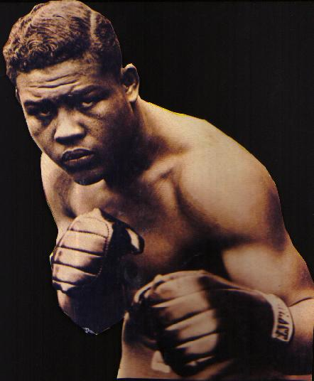
Story-telling with a Purpose…
What’s the difference between a story and a story used as support in an essay?
What’s the “so what?” factor?

Slide 39
Journal #1
Part One:
Complete the Questions for discussion/analysis on Champion of the World
Part Two:
Take the Narrative Essay assignment and spend 15 to 20 minutes tonight generating prewriting.
You should employ one of the techniques covered in class today.
Note: If you choose to use prewriting generated by your diagnostic, make sure to add to it during this time and resubmit it.

Slide 40
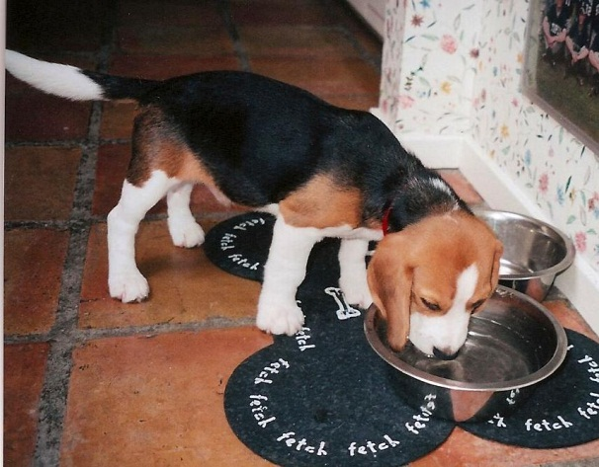
Workshop #1: Grammar Review
What is a complete sentence?
Subject Predicate
The dog ate its food.
Complete subject
Complete predicate
Makes sense/provides enough information to complete a thought

Slide 41
Sentence Errors
Fragments—either the subject or predicate is missing; the thought is incomplete
Run-on Sentences—there is a lack of proper separation between complete thoughts
Comma Splices—there is a lack of proper separation between complete thoughts and a comma is used where a stronger mark of punctuation should be

Slide 42
Workshop #1
General Guidelines—
Work with a partner; no more than three per group
Place everyone’s name at the top of your assignment (to ensure credit)
Complete the practice exercise; then, “trade” to score and discuss your results
Ask questions
Make corrections where needed

